Slide 1


Apache Lucene
Vijay Kumar NM

Slide 2
Road Map
Problem Definition
A Basic Search Engine Pipeline
Meet Lucene
Lucene API Examples
Lucene Wrappers (Apache Solr, ElasticSearch, Regain, etc….)
Applied Lucene (Real Examples)

Slide 3
Problem Definition
You got a farm of data, and you want it to be searchable.
Analogy: Searching for a needle in a haystack with adding more hay to the stack!
SQL Databases Cons ( > 500,000,000 records …)
Scalability
Decentralization

Slide 4
What is Lucene?
Doug Cutting (Lucene 1999, Nutch 2003, Hadoop 2006)
Free, Java information retrieval library
Application related: Indexing, Searching
Sources can be SQL/NoSQL, Web Site, File System
High performance, A decade of research
Heavily supported, simply customized
No dependencies

Slide 5
What Lucene Ain’t
A complete search engine
An application
A crawler
A document filter/recognizer

Slide 6
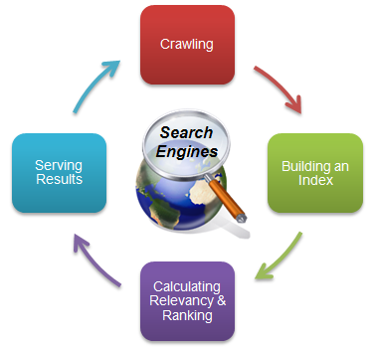
A Basic Search Engine Pipeline
Crawling: Grapping the data
Parsing [Optional]: Understanding the data
Indexing: Build the holding structure
Ranking: Sort the data
Searching: Read that holding structure
Behind The Scenes: Analysis, Tokenization, Query Parsing, Token Filtration, Index Inversion, etc…

Slide 7
Lucene Roles
Rich Document
Rich Document
Search UI
Gather Parse
Search App e.g. webapp
Make Doc
Index
Search
Index

Slide 8
Lucene Strength Points
Simple API
Speed
Concurrency
Smart indexing (Incremental)
Near Real Time Search
Heavily Used, Supported

Slide 9
Concepts

Slide 10
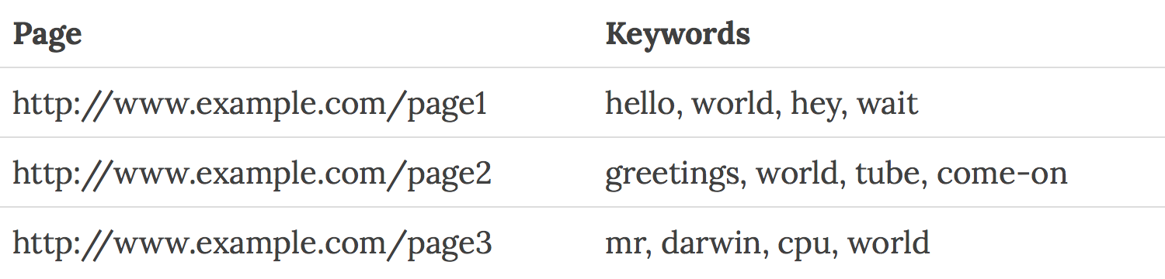
1. Searching and Indexing
Fast because, it searches an index instead of searching the text.
Uses Inverted index, equivalent of retrieving pages in a book related to a keyword by searching the index at the back of a book, as opposed to searching the words in each page of the book.
Forward Index

Slide 11
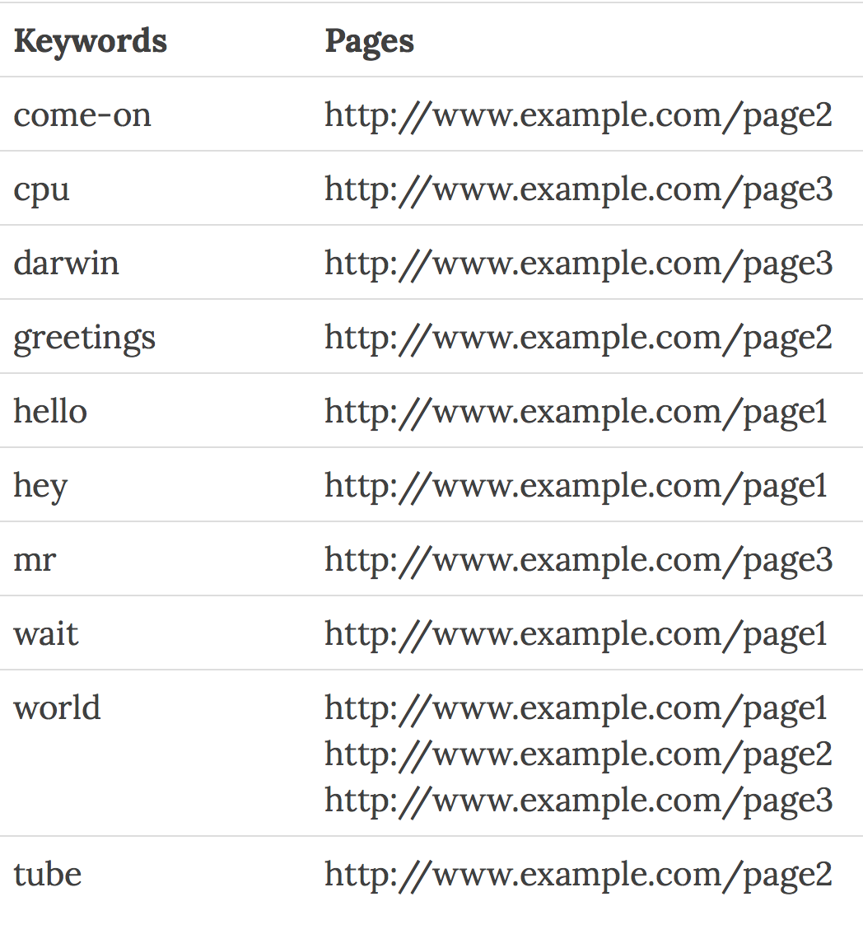
Inverted Index

Slide 12
2. Documents
Document is the unit of search and index in Lucene
An index consists of one or more Documents.
Indexing involves adding Documents to an IndexWriter
Searching involves retrieving Documents from an index via an IndexSearcher.
A Lucene Document doesn't necessarily have to be a document in the common English sense

Slide 13
3. Fields
A Document consists of one or more Fields.
A Field is simply a name-value pair. For example, title.
Indexing in Lucene thus involves creating Documents comprising of one or more Fields, and adding these Documents to an IndexWriter.

Slide 14
4. Searching and Queries
Search involves creating a Query (usually via a QueryParser) and handing this Query to an IndexSearcher, which returns a list of Hits.
Lucene has its own mini-language for performing searches, called Lucene query language
The Lucene query language allows the user to specify
which field(s) to search on,
which fields to give more weight to (boosting),
the ability to perform boolean queries (AND, OR, NOT)
and other functionality.

Slide 15
Lucene Query Types
Single Term VS. Multi-Term “+name: camel + type: animal”
Wildcard Queries “text:wonder*”
Fuzzy Queries “room~0.8”
Range Queries “doj:[25/5/2000 To *]”
“title:{Apple To Banana}”
Grouped Queries “text: animal AND small”
Proximity Queries “apache Jakarta”~10
Boosted Queries “apache^5.0 AND Jakarta”

Slide 16
Lucene Indexing Pipeline
Tokenizer
TokenFilter
Document Writer
add
Document
Inverted Index

Slide 17
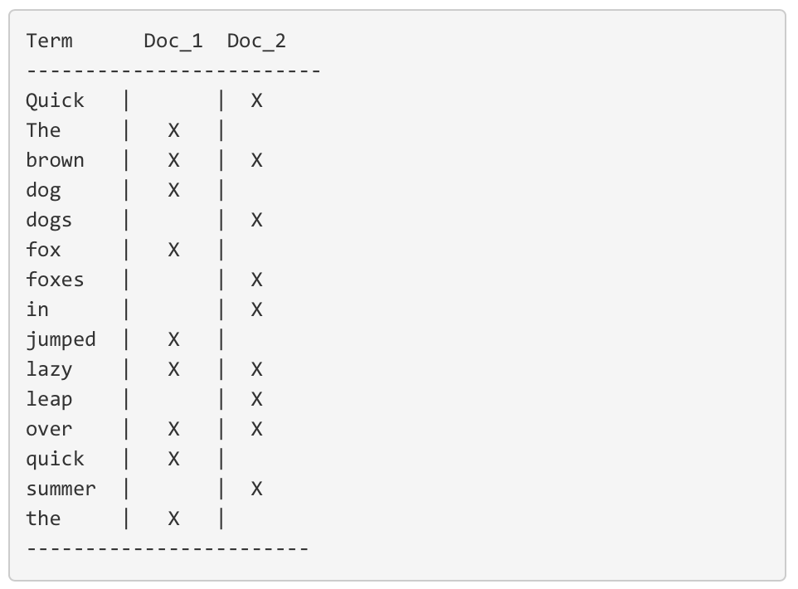
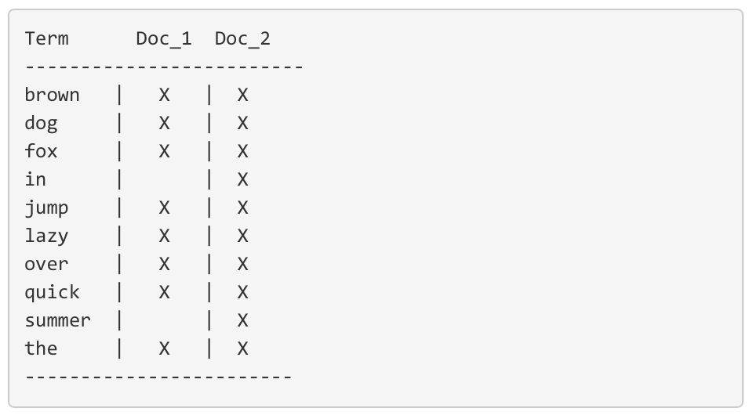
Stemming, Normalization and Lemmatization
Notes:
quick brown
But there are a few problems with our current inverted index:
Quick and quick appear as separate terms, while the user probably thinks of them as the same word.
fox and foxes are pretty similar, as are dog and dogs; They share the same root word.
jumped and leap, while not from the same root word, are similar in meaning. They are synonyms.

Slide 18
Analysis and Analyzer
This process of tokenization and normalization is called analysis, it consists of
First, tokenizing a block of text into individual terms suitable for use in an inverted index,
Then normalizing these terms into a standard form to improve their “searchability,” or recall
Analysis is performed by analyzers. An analyzer is really just a wrapper that combines three functions into a single package:
Character filters: The string is passed through any character filters to tidy up the string before tokenization. A character filter could be used to strip out HTML, XML or to convert & characters to the word and.
Tokenizer: Next the string is tokenized into individual terms by a tokenizer. A simple tokenizer might split the text into terms whenever it encounters whitespace or punctuation.
Token filters: Last, each term is passed through any token filters in turn, which can change terms (for example, lowercasing Quick), remove terms (for example, stopwords such as a, and, the) or add terms (for example, synonyms like jump and leap).

Slide 19
Analysis Basic Types
"The quick brown fox jumped over the lazy 5 dogs”
StandardAnalyzer (default)
[quick] [brown] [fox] [jumped] [over] [lazy] [5] [dogs]
SimpleAnalyzer :
[the] [quick] [brown] [fox] [jumped] [over] [the] [lazy] [dogs]
WhitespaceAnalyzer :
[The] [quick] [brown] [fox] [jumped] [over] [the] [lazy] [5] [dogs]
StopAnalyzer :
[quick] [brown] [fox] [jumped] [over] [lazy] [5] [dogs]
Notes:
Note that you can even make your custom analyzers, It depends on the application needs

Slide 20
Thank You

